Slide 1


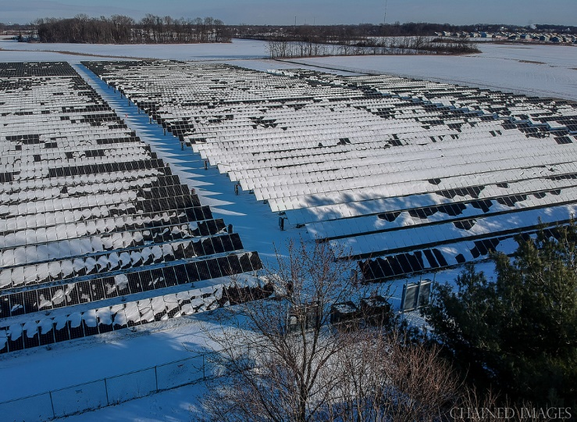
Greenfield Power & Light
Proposed Electric Rate Adjustments
PRESENTED BY:
Otto W. “Buzz” Krohn, Executive Partner
O. W. Krohn & Associates, LLP
Rate Consultants & SEC Registered Municipal Advisors

Slide 2
Municipal Electric Rates
Indiana Code 8-1.5-3-8
Establishes Statutory Revenue Requirements for Municipal Electric Utilities
Municipal Electric Rates SHALL BE SUFFICIENT to cover:
  Cash Operation & Maintenance Expense
  Debt Service on Bonds & Other Indebtedness
  Debt Service Reserves & Working Capital
  Depreciation and/or Allowance for Replacements & Improvements
Additional Provisions MAY include:
  Payments in Lieu of Taxes – PROPOSED RATES INCLUDE PILOT PMTS
  Return on Plant – PROPOSED RATES

Slide 3
Pro Forma Revenue & Revenue Requirements

Slide 5
Eliminated Inverted Rate For Residential Ratepayers
Current Residential Rates Were Inverted for > 2,500 Kwhs per Month

Slide 6
Small Commercial Customers Will Now Pay Same Energy Charge as Residential Users

Slide 7
Industrial Rates & Base Cost of Power
Putting “Cap” on Coincident Peak Demand Credits
Limited to 70% of Actual Peak Demand

